Slide 1
Wine & Food Pairing
The
App

Slide 2
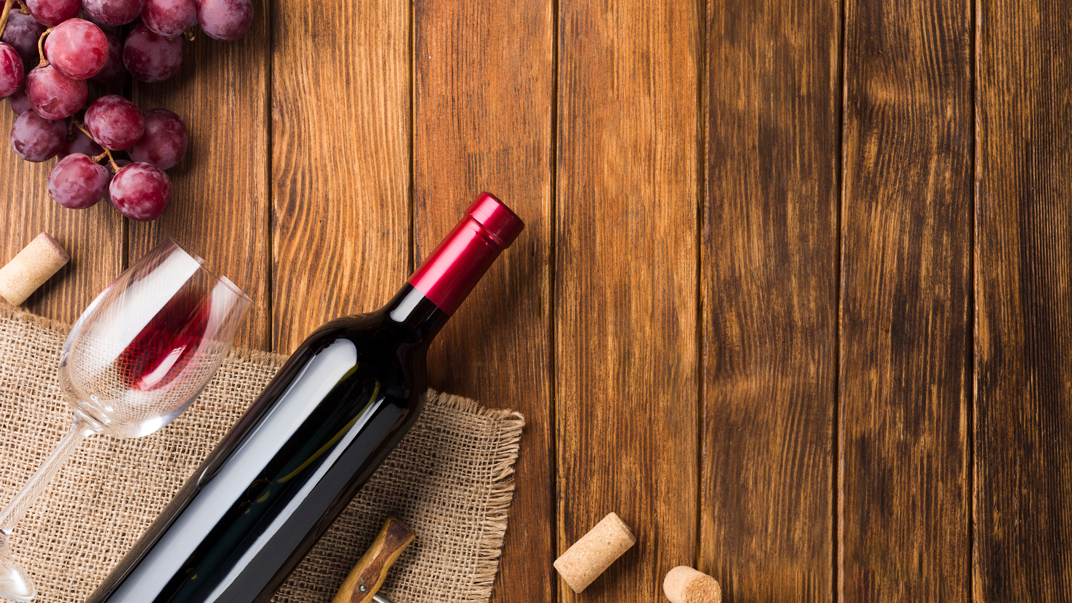

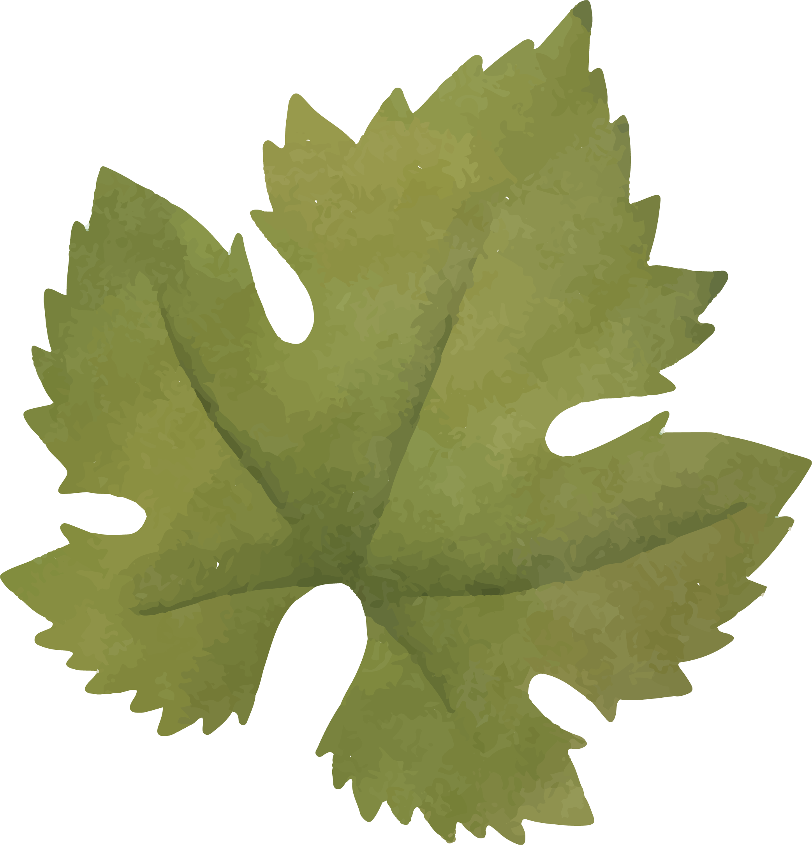
A
Little Introduction…

Slide 3
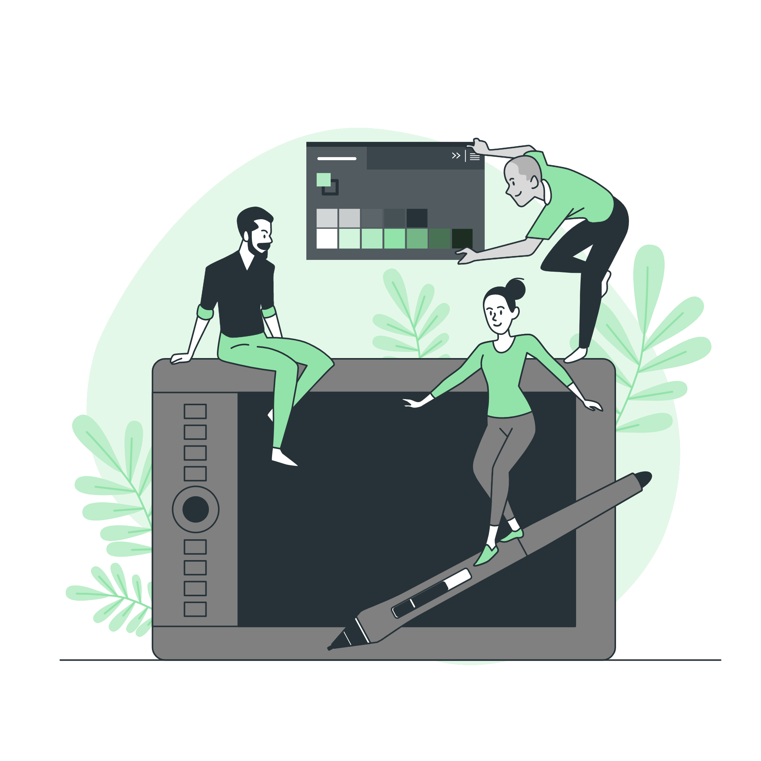


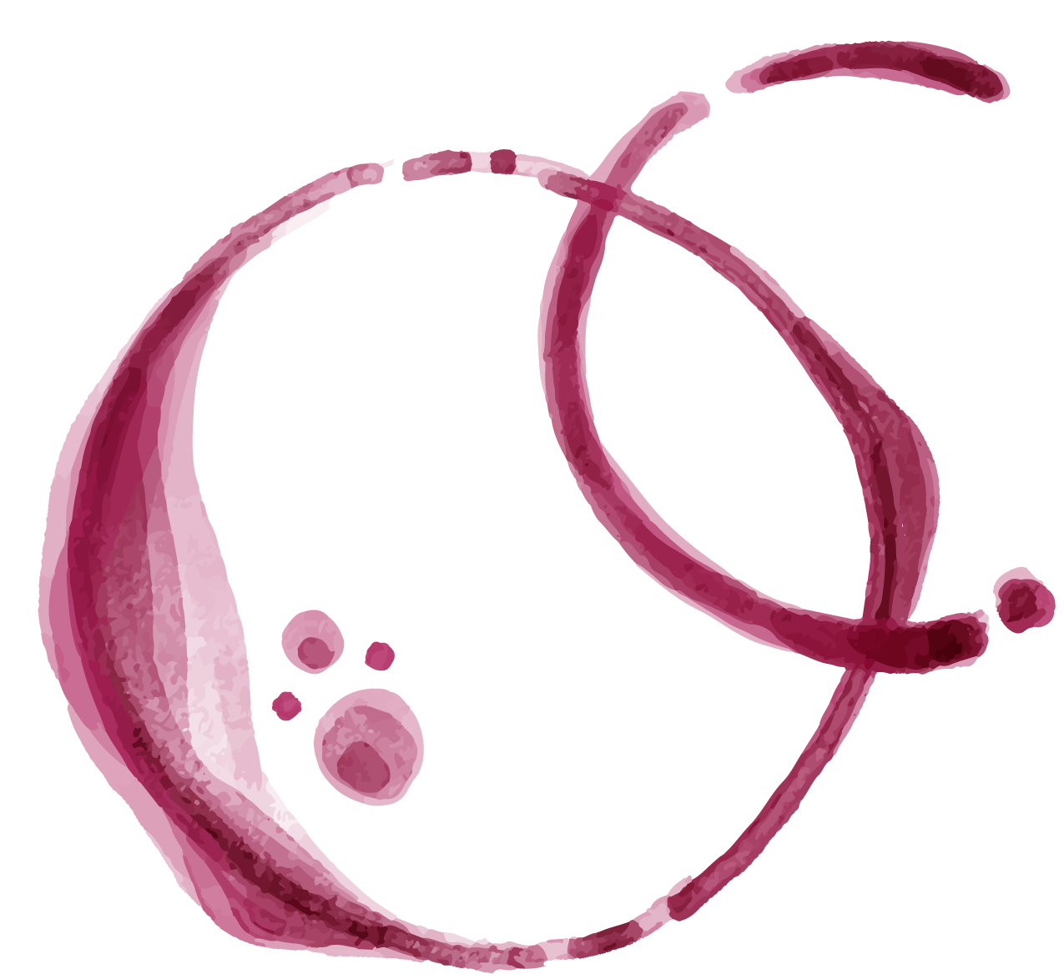

The Team…
This project is brought to you by:
Blago Dishkov
Gellert Eke
Bronwen Jenner
Front-End Web Dev
Graduate Dev
Front-End Web Dev
Notes:
Each introduce ourselves.

Slide 4
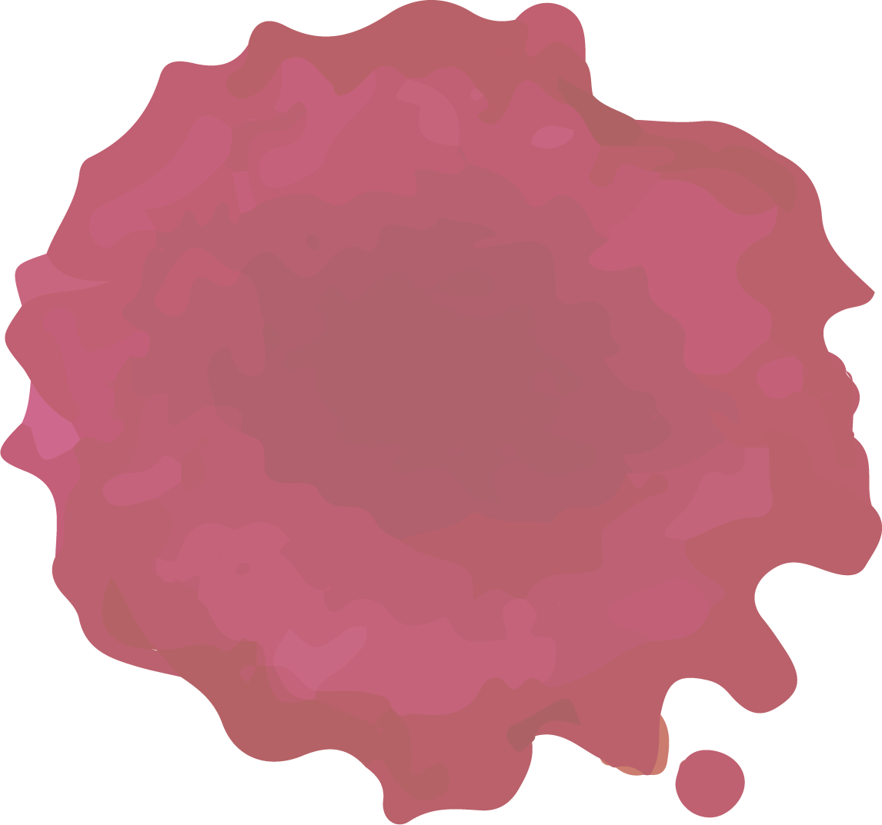
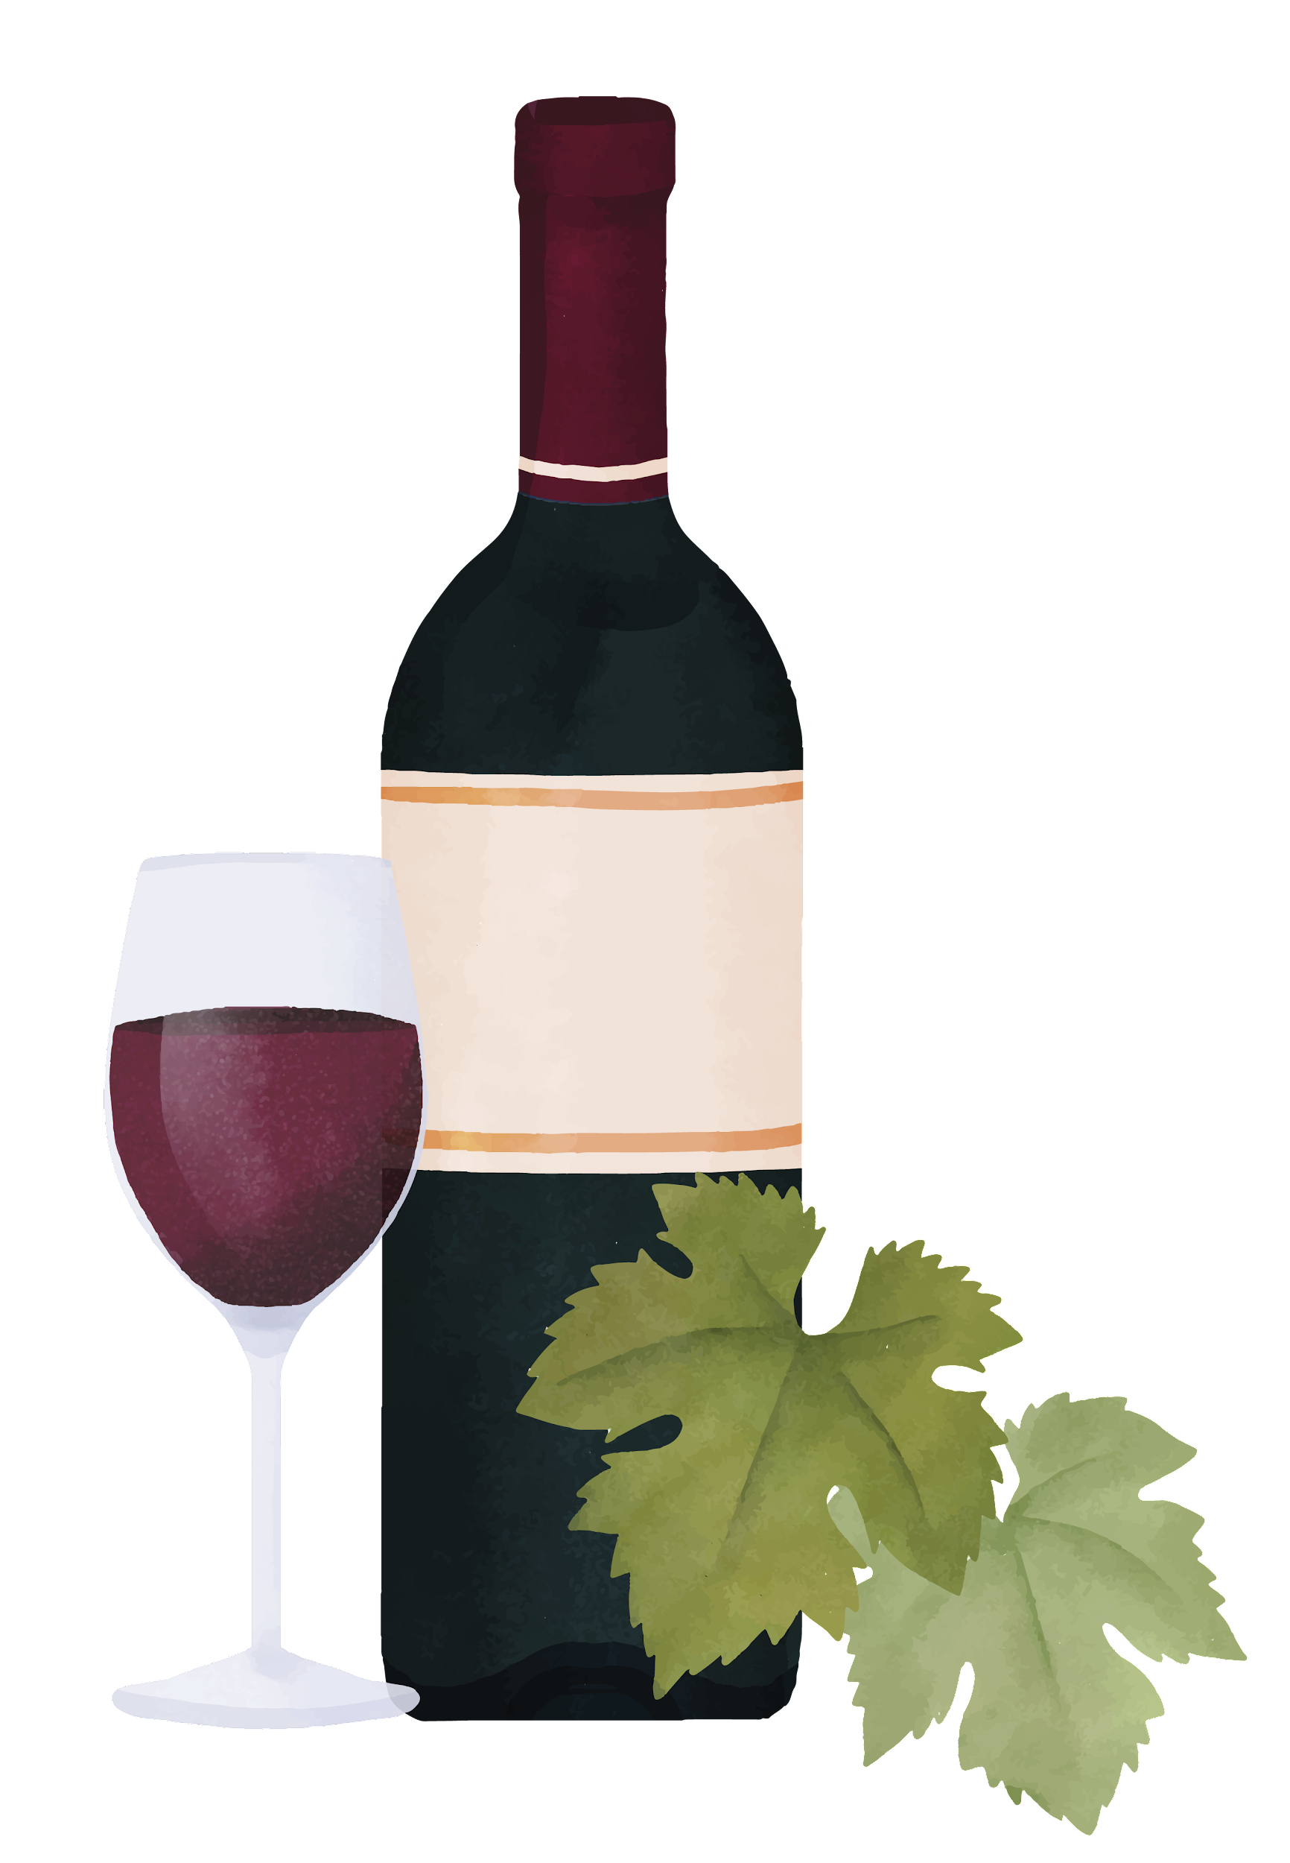
Introduction
From novice to connoisseur… this app is designed to be used by all as the perfect accompaniment to any truly great dining experience.
Simply enter either the meal or wine that you wish to pair and the app will generate a list of suitable culinary companions for the user to choose from for their meal.
Hosting the perfect dinner party has never been easier!

Slide 5


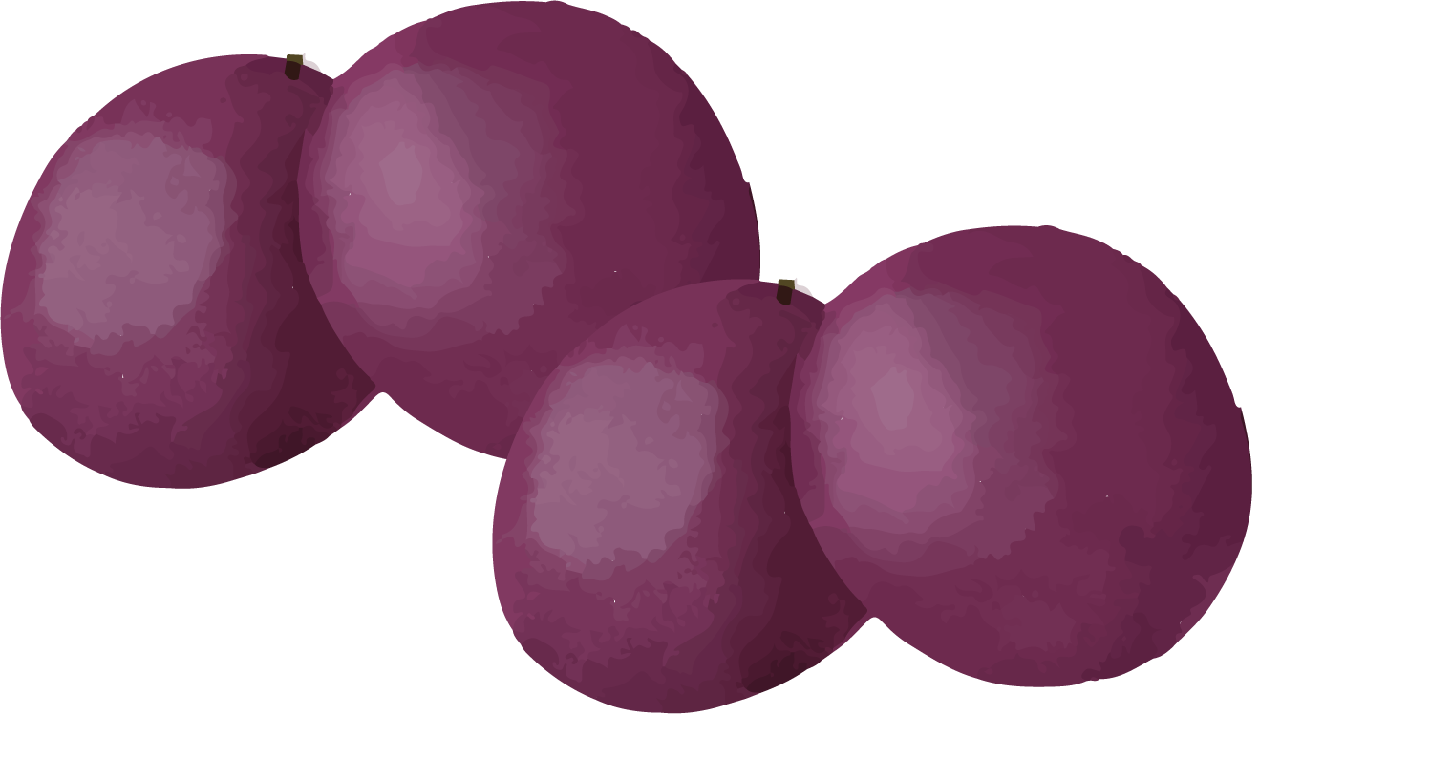
Concept
Food
Wine
Type any meal or food group into the search bar to receive a specialised list of wines to accompany the meal.
Type any wine name or wine group into the search bar to receive a menu of meal options and food groups to compliment the wine choice.
Concept
Notes:
Blago: Food will bring up wine recommendations.
Gellert: Vice versa with wine, which will bring up food recommendations.
Bronwen: More affordable and premium wines are shown.

Slide 6
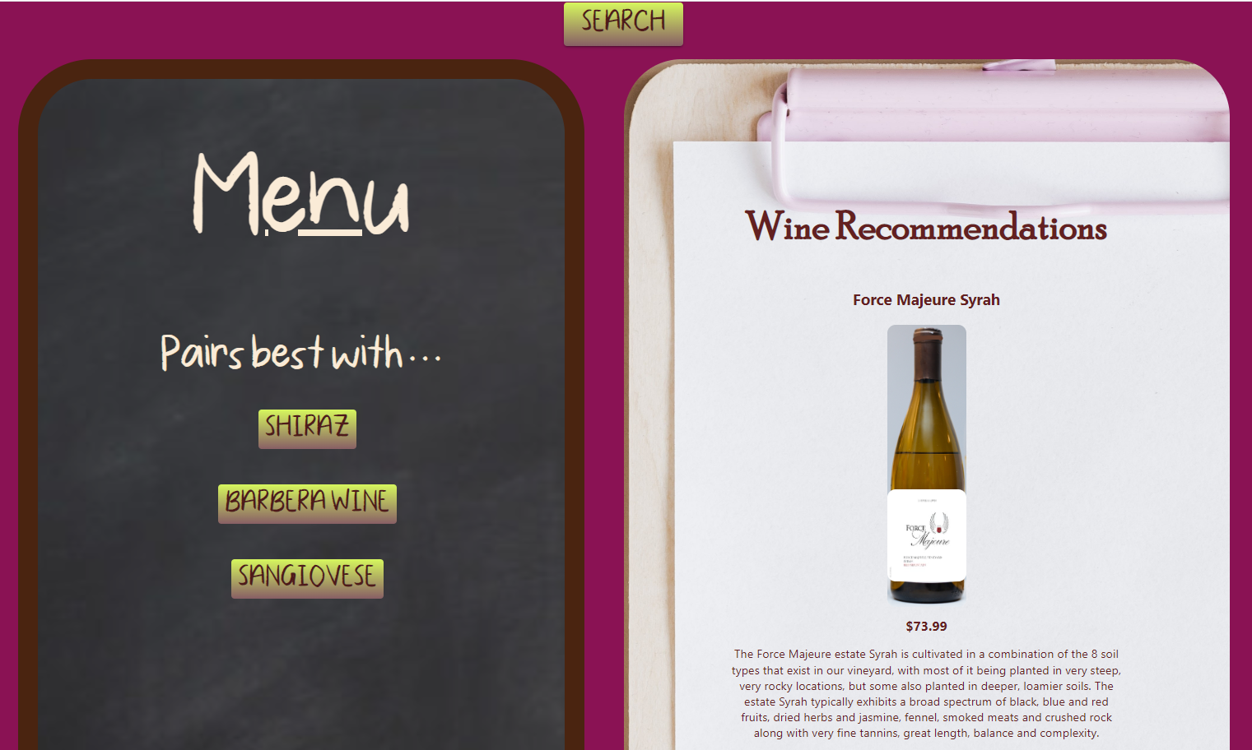

Layout
Notes:
Blago:
Gellert:
Bronwen:

Slide 7
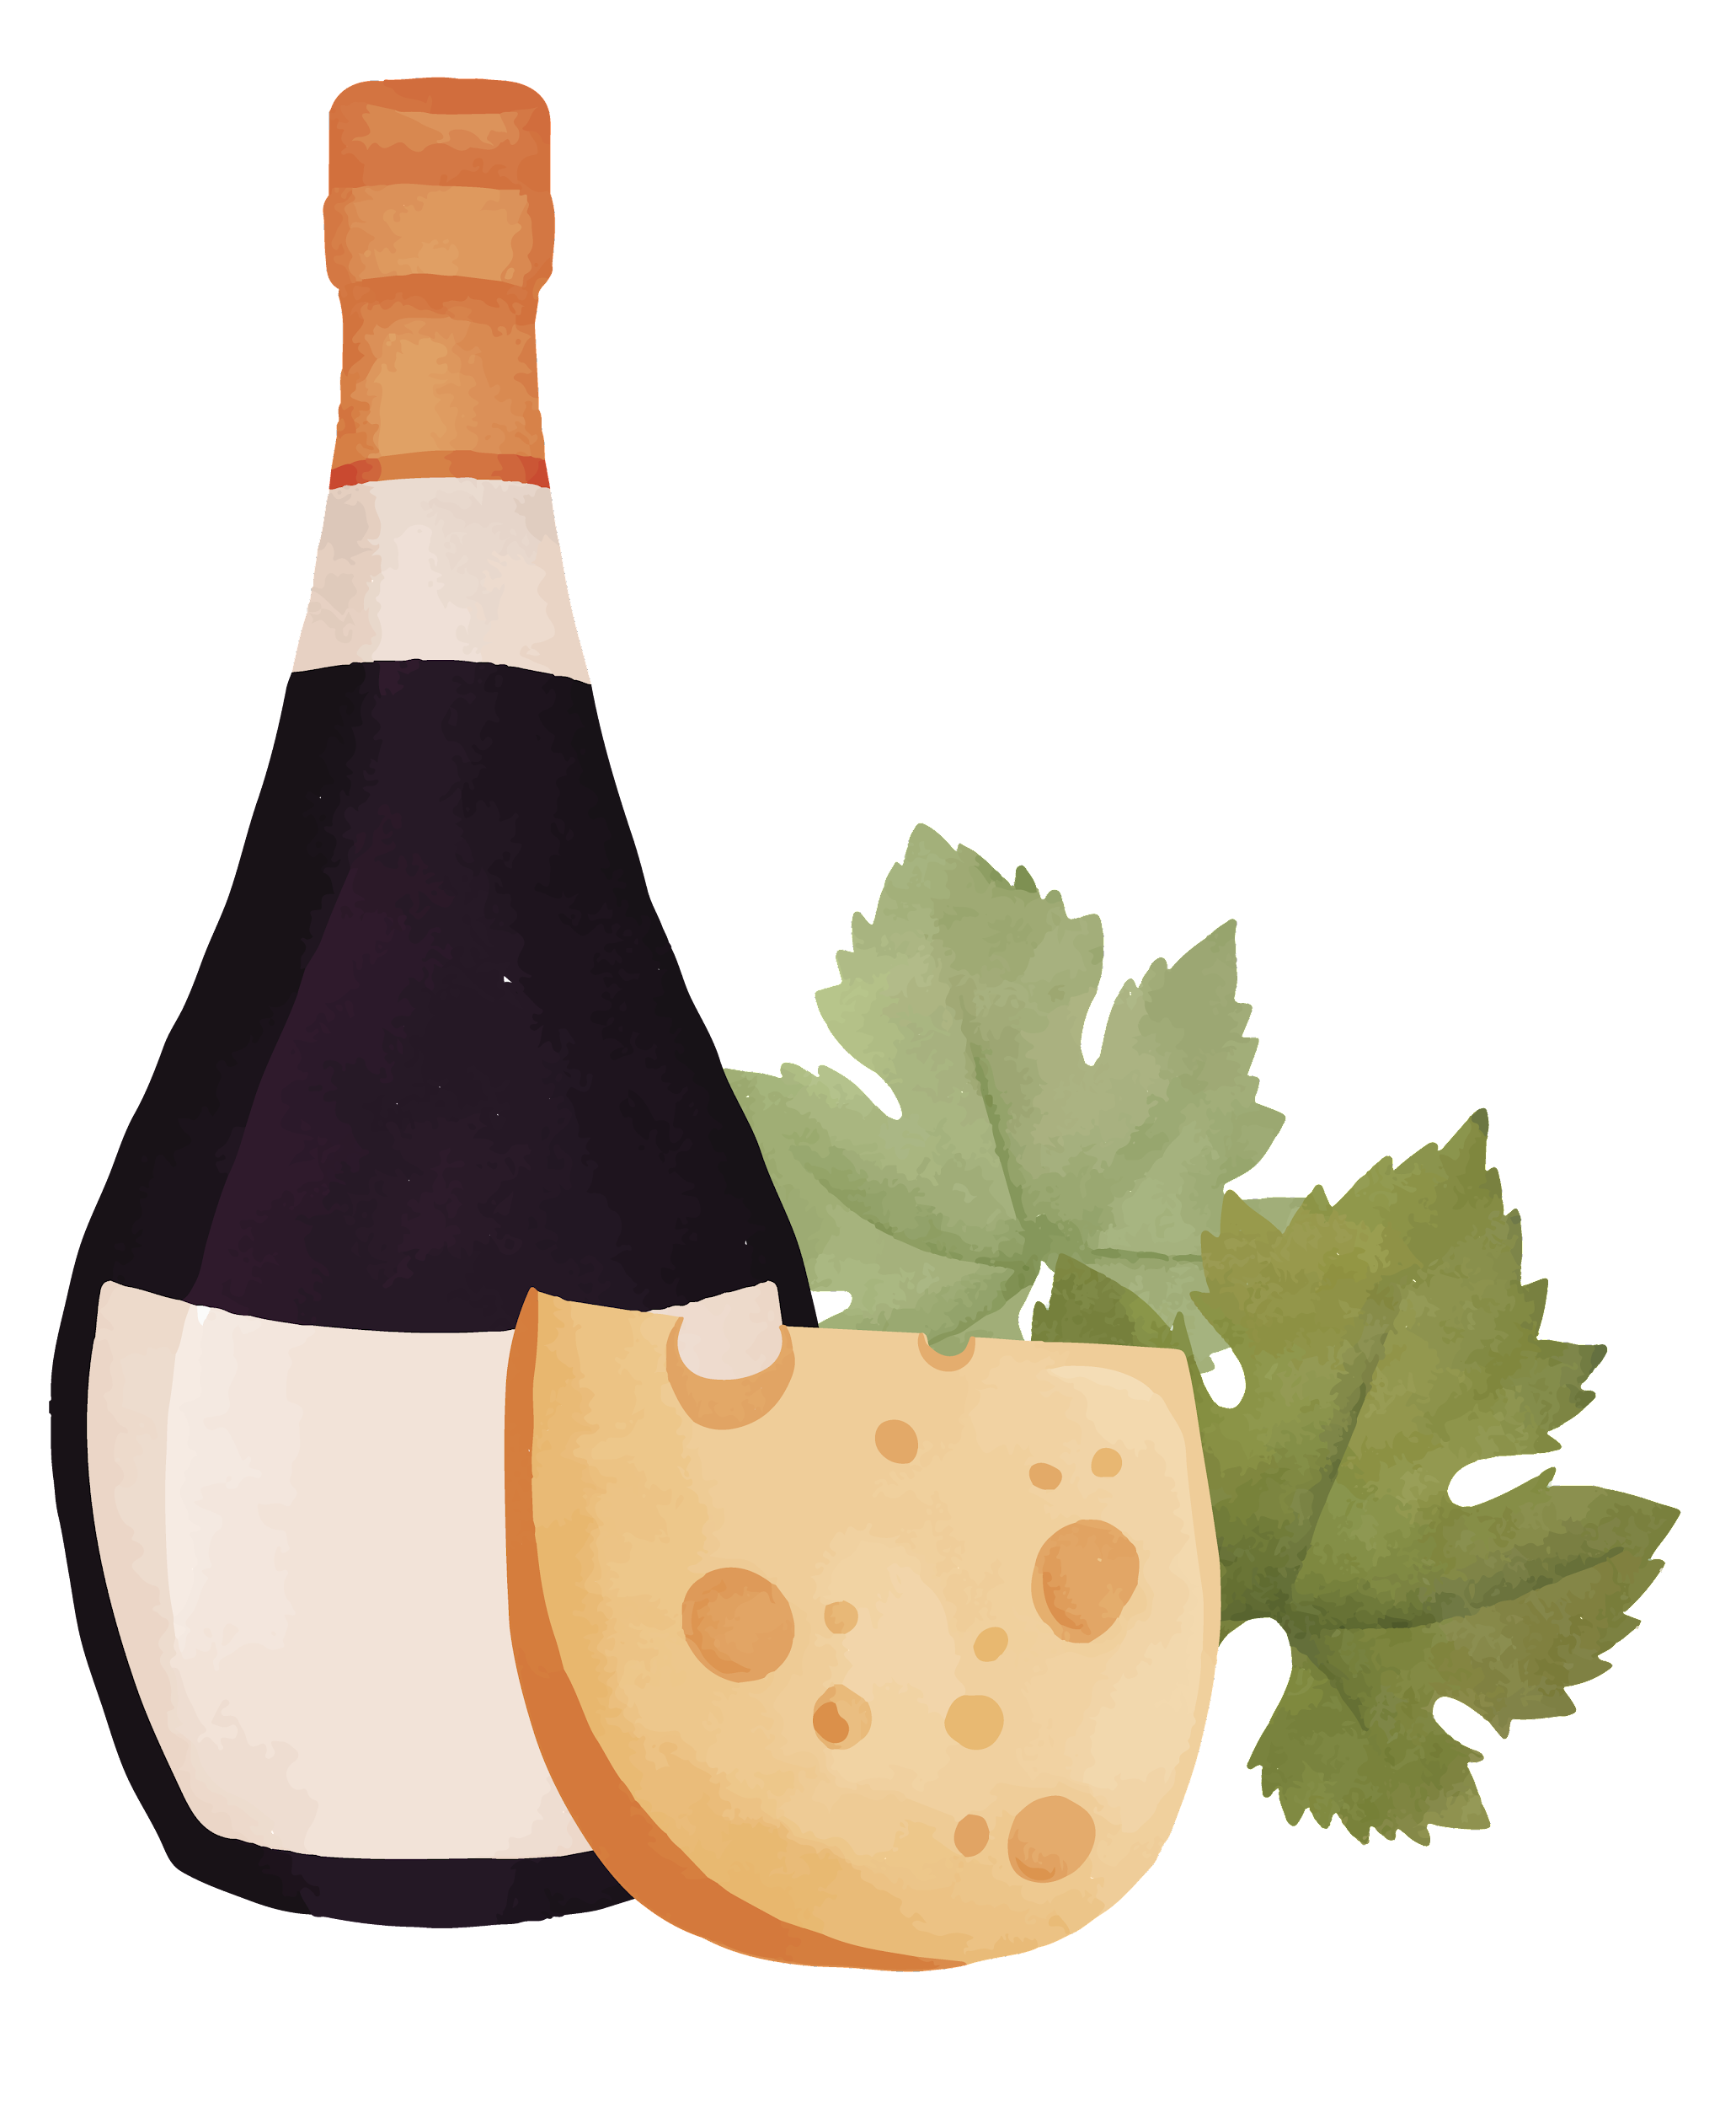
Why Wine?
This app was created to be accessible for anyone to use across a wide variety of demographics. This project was designed with the following attributes in mind:
Knowledgeable APIs capable of delivering the most relevant information.
A fun yet formal theme.
An easy-to-use interface.
The idea was that anyone should be able to host the perfect meal to impress dinner guests by sharing knowledge about wine-food pairings.
Notes:
Blago:
Gellert:
Bronwen:

Slide 8
The Plan Of Action
01
02
03
04
User Interface Fine-Tuning
Plan Conceived
Functionality Executed
Layout Mapping
The initial concept of the app was established.
APIs were researched, selected and then implemented into code.
The lay-out for the web-page was designed and then executed.
The user interface was tweaked to become more aesthetically pleasing and to enhance accessibility.
Notes:
Blago: 01, 02
Gellert: 03 ->
Bronwen: 04

Slide 9

Technologies Used
01
02
03
04
Technologies Used:
Languages Used:
Usage:
JavaScript
CSS
HTML
Clone the file from [https://github.com/boxitooo6629/Wine-Food-Pairing-App]
The technologies used in this project were…
Material UI
React
ReactQuery
fullPage.js
API Spoonacular
Node.js
Git Bash: npm install
Create an account in [https://spoonacular.com/food-api], then copy the API and paste into the variable
const apiKey.
Git Bash: npm run start
Notes:
Blago:
Gellert:
Bronwen:

Slide 10
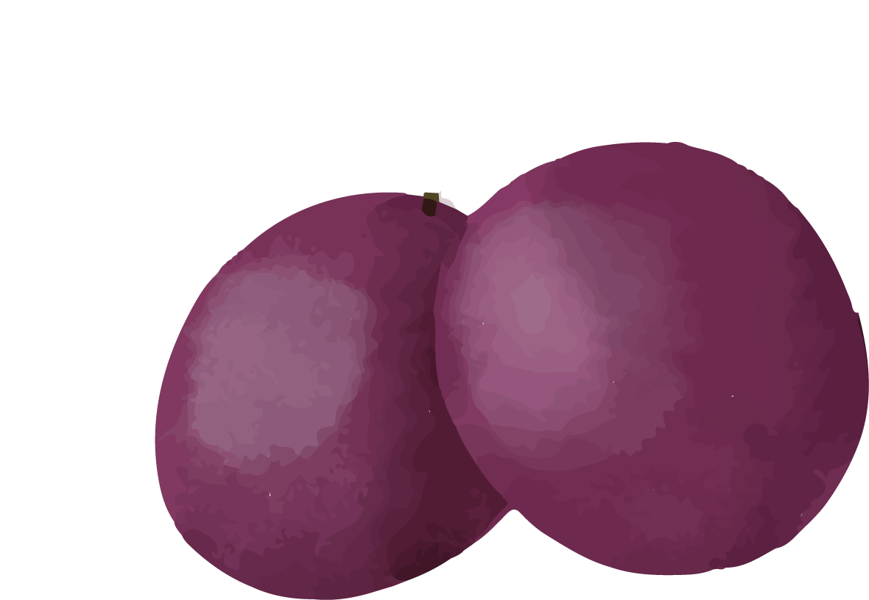
Resources
APIs:
Spoontacular ‘Food Pairings’
Spoontacular ‘Wine Reccomendations’
Other Resources:
mui.com/material-ui/
VScode
Netlify
Github
GoogleSlides
SlidesGo
Pictures, Icons & Badges:
Shields.io
Pexels
Lordicon Icons
ReactQuery
React
Notes:
Blago:
Gellert:
Bronwen:

Slide 11
Tasks & Roles
Blago
Gellert
Bronwen
Implementation of fullPage.js, React Router, MUI react component library.
Creation of basic layout of the page.
Sourced assets such as images, templates, icons and gifs.
Added styling to pages.
Created presentation slide-show.
Fetching API, Creating Search Wine Engine, Responsive Wine to Food and Food to Wine
Adding Styles and Creating Main pages Mobile Friendly
Notes:
Blago:
Gellert:
Bronwen:

Slide 12
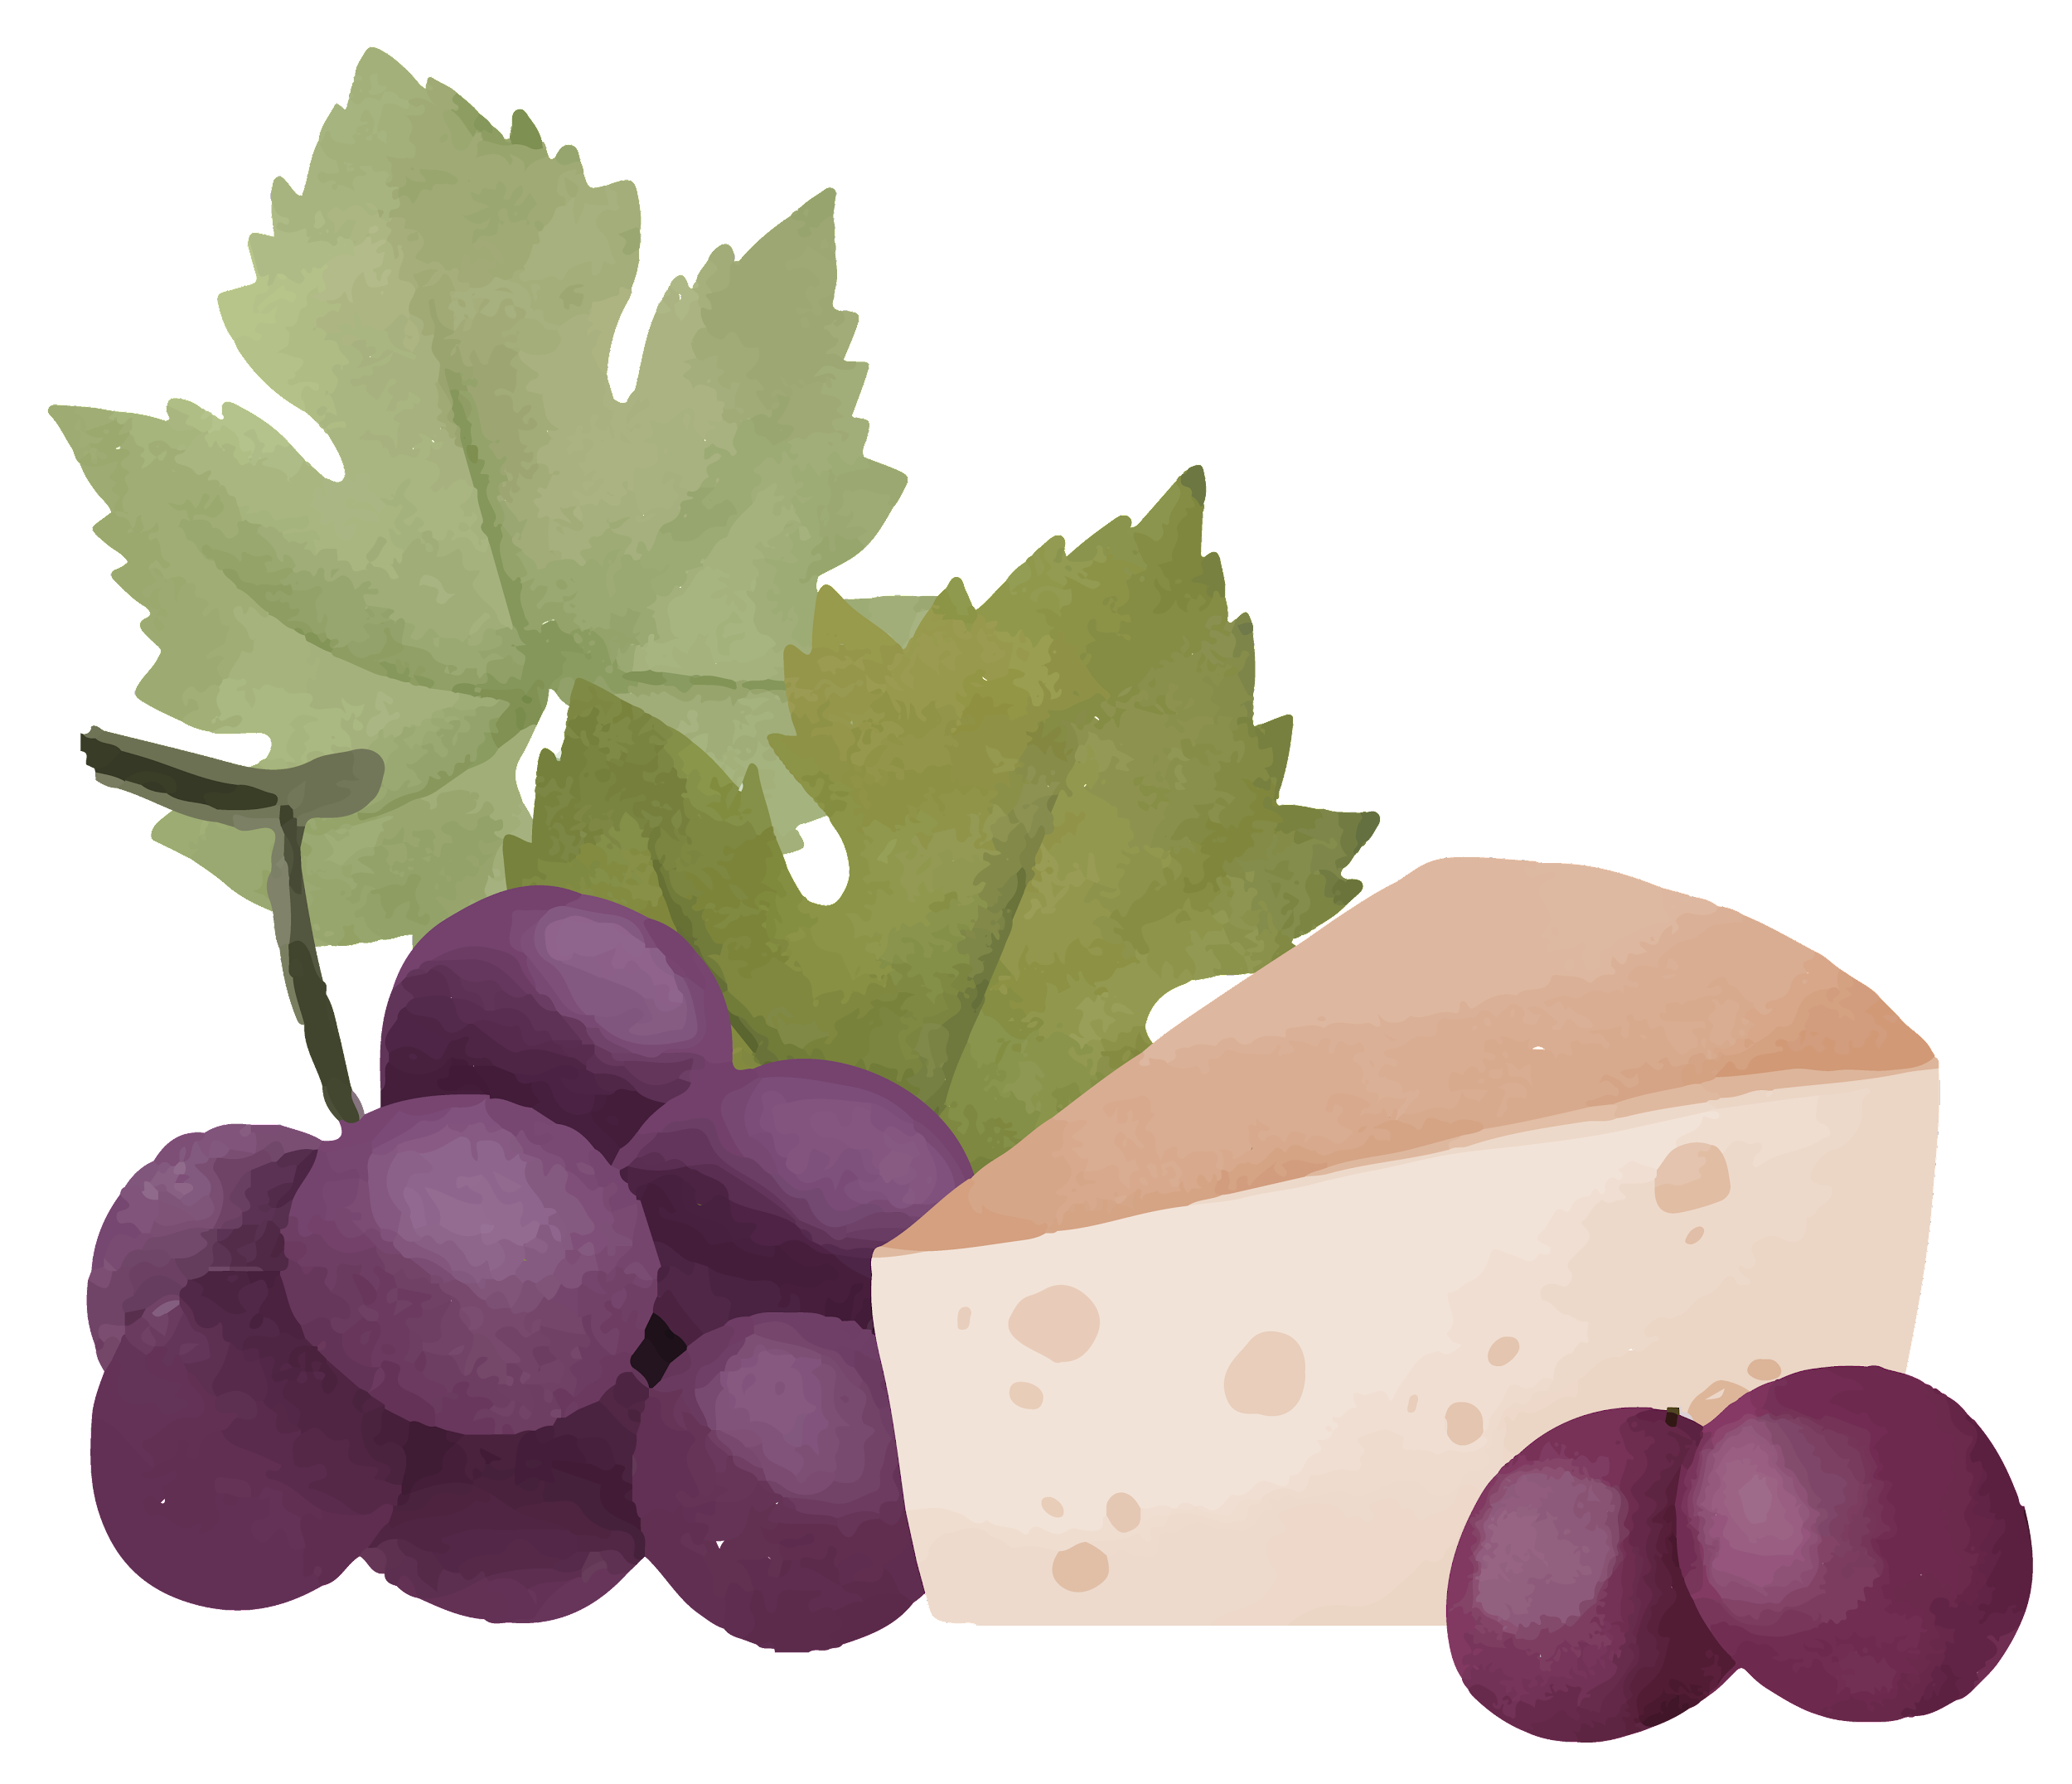
Challenges
&
Successes
Notes:
Blago:
Gellert:
Bronwen:

Slide 13

Challenges
01
02
03
Finding right API that will show the information you need
API key works with quotas of 150 points once you reach them you have to create new account and use new API key
Using ReactQuery and fetching data, render and display information
04
It was a challenge learning and using Materials UI- a lot of CSS was also used.
Also merging had it’s challenges.
05
Reworking logic to start API calls on button click event instead of form submit.
Notes:
Blago:
Gellert: ->
Bronwen:

Slide 14

Successes
01
02
03
Managing to create a functional search button that works both ends Wine=>Food, Food=>Wine
Successfully created depth to api info with styled UI.
Succeeding with implementing fullPage.js
Notes:
Blago:
Gellert:
Bronwen:

Slide 15

Future Development
Develop more content for certain wines and foods not yet utilised in the API.
Develop more content for wine regions, food recipes, youtube videos about the wine/food and recommended youtube content creators.
Add links from the food pairings to recipes.
Enable the user to add food/wine pairings to favourites.
Future
Notes:
Blago:
Gellert:
Bronwen:

Slide 16
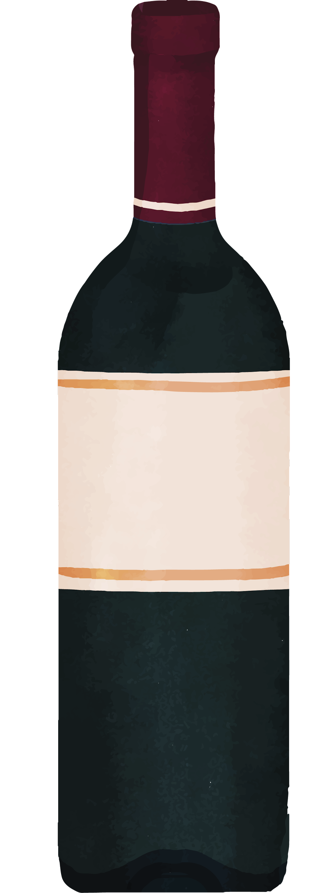
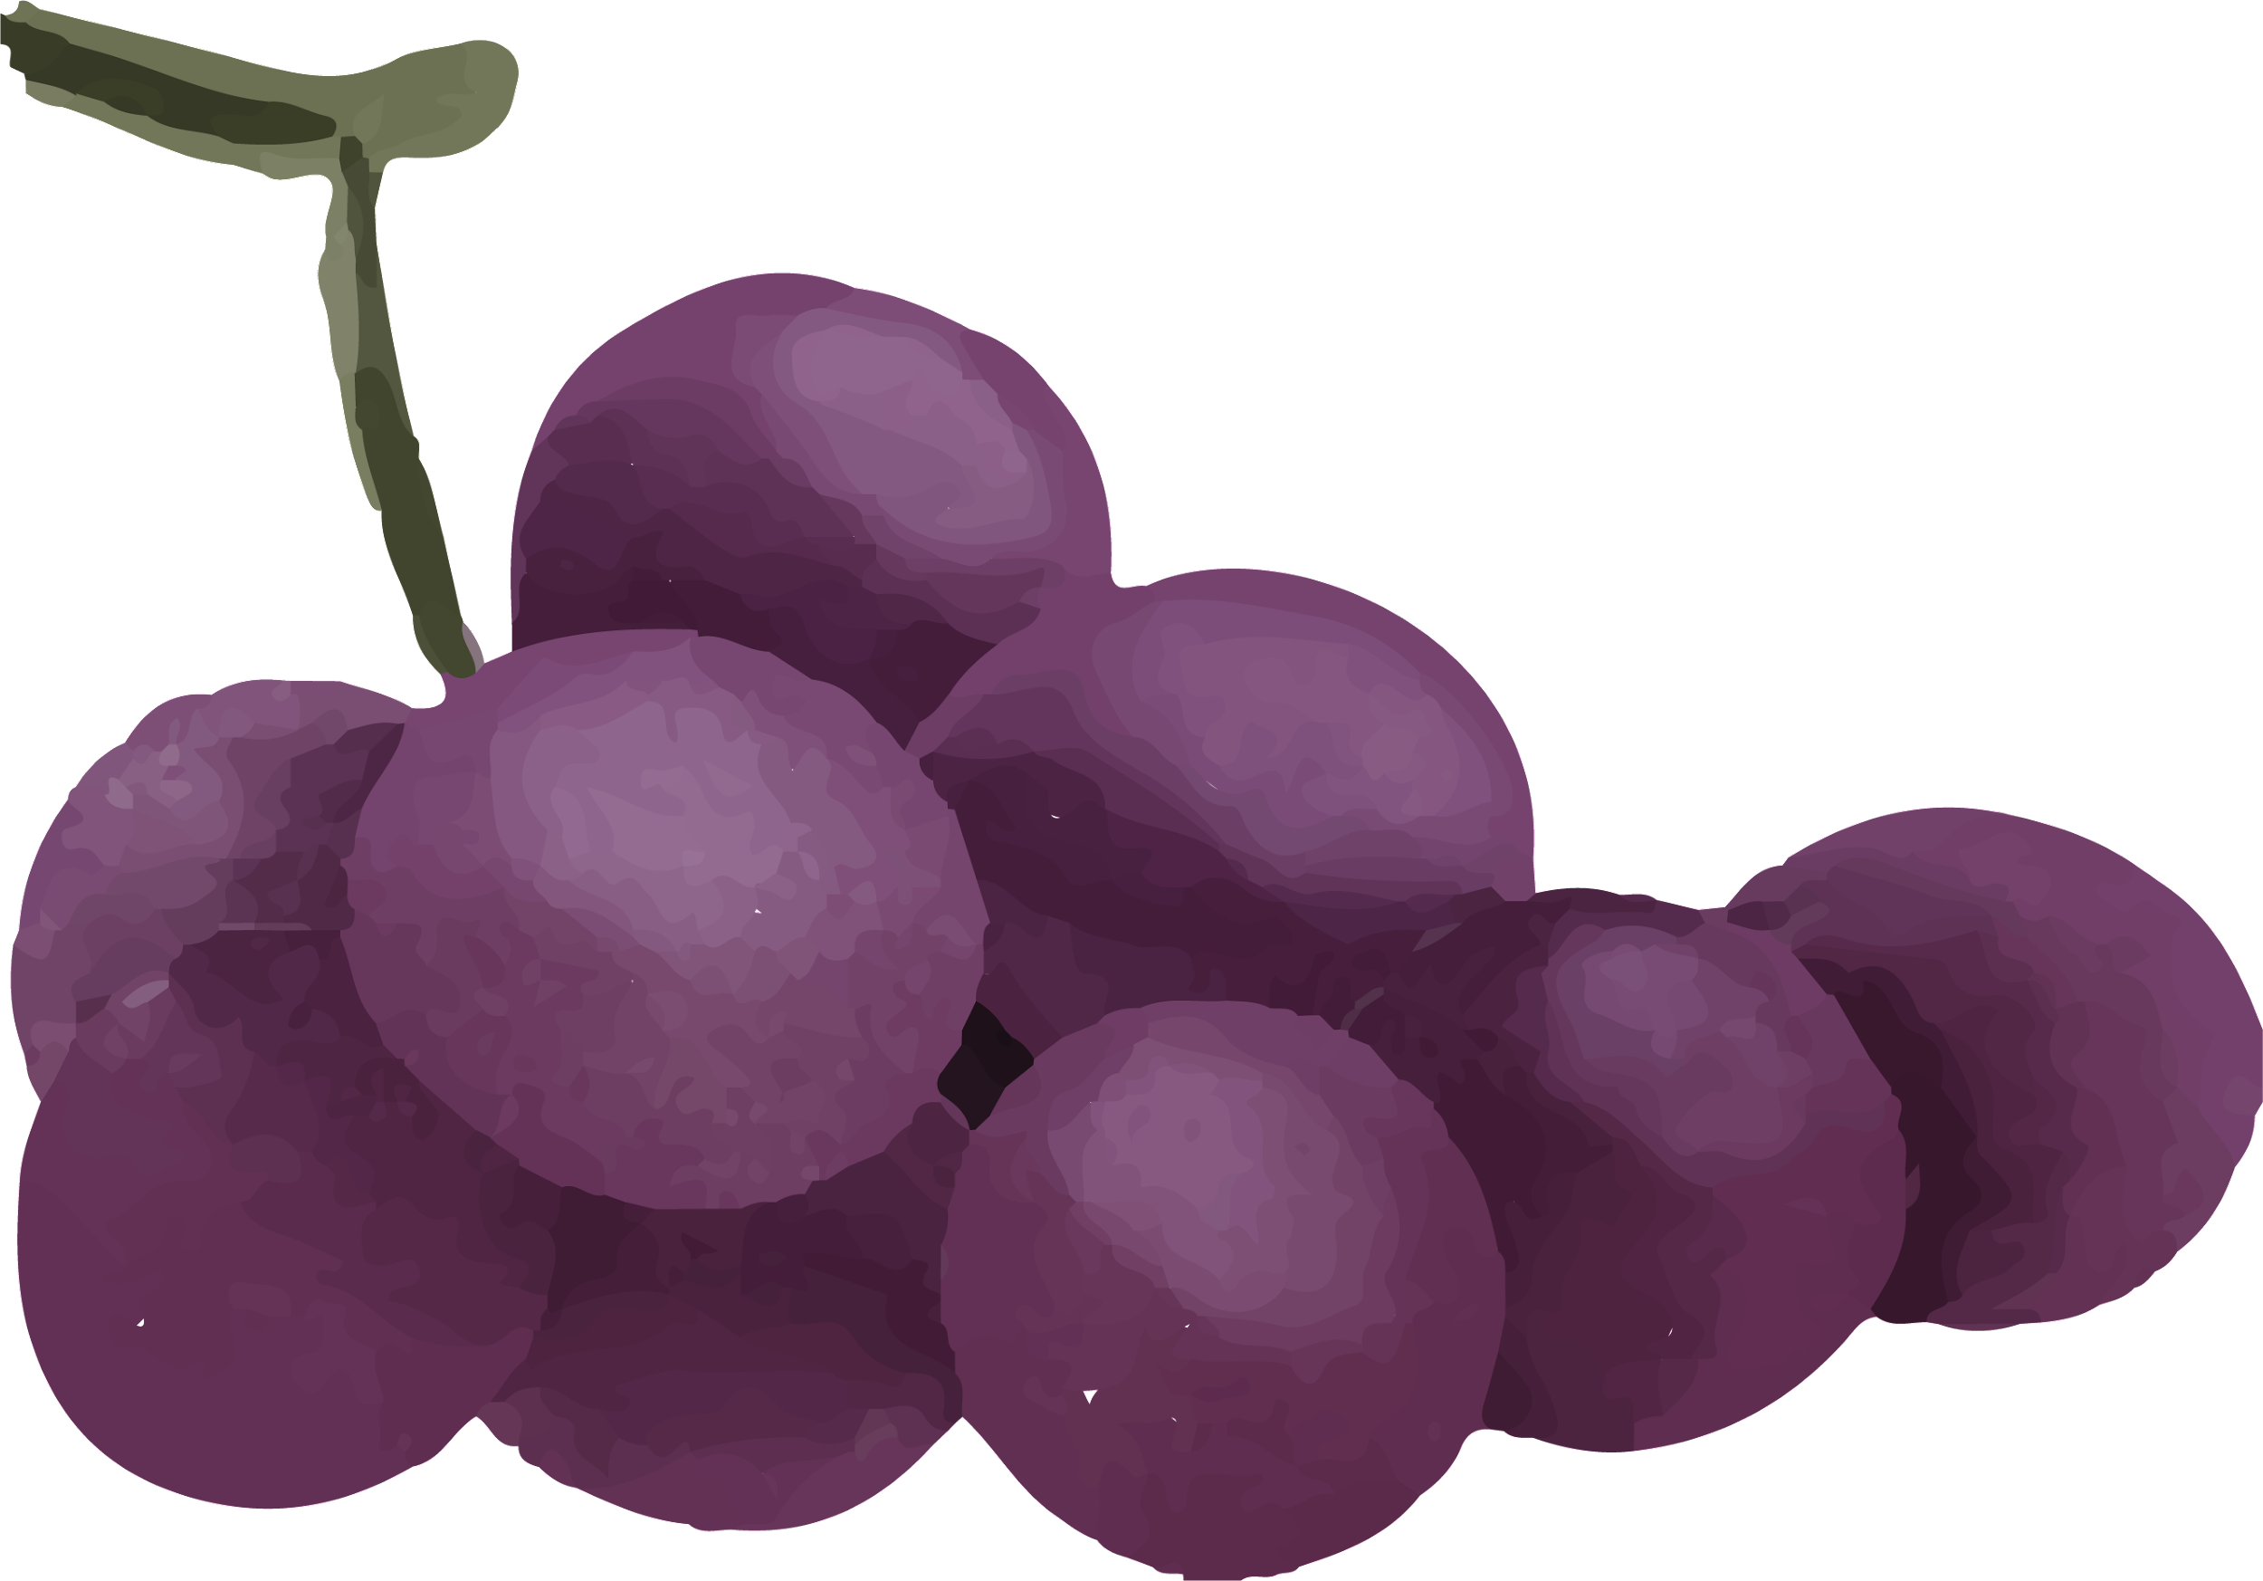
— Andre Simon
“Wine makes every meal an occasion, every table more elegant, every day more civilized.”
- Andre Simon
Notes:
Blago:
Gellert:
Bronwen:

Slide 17
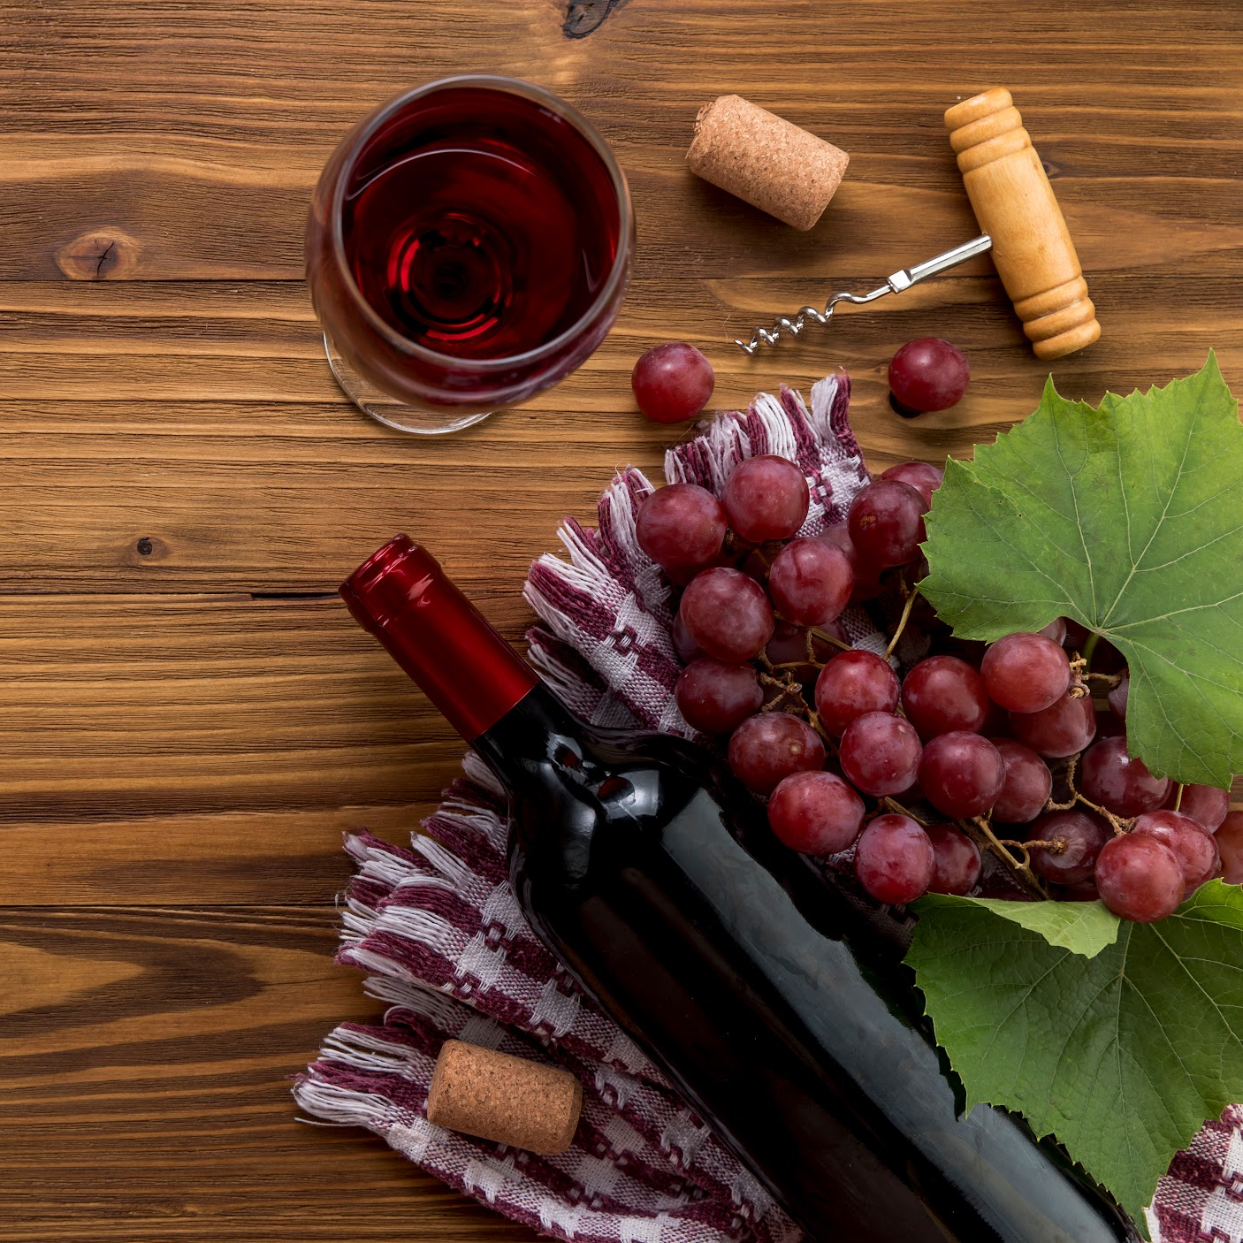
Now To Our App Demonstration!
Queue the demo...
Notes:
Blago:
Gellert:
Bronwen:

Slide 18

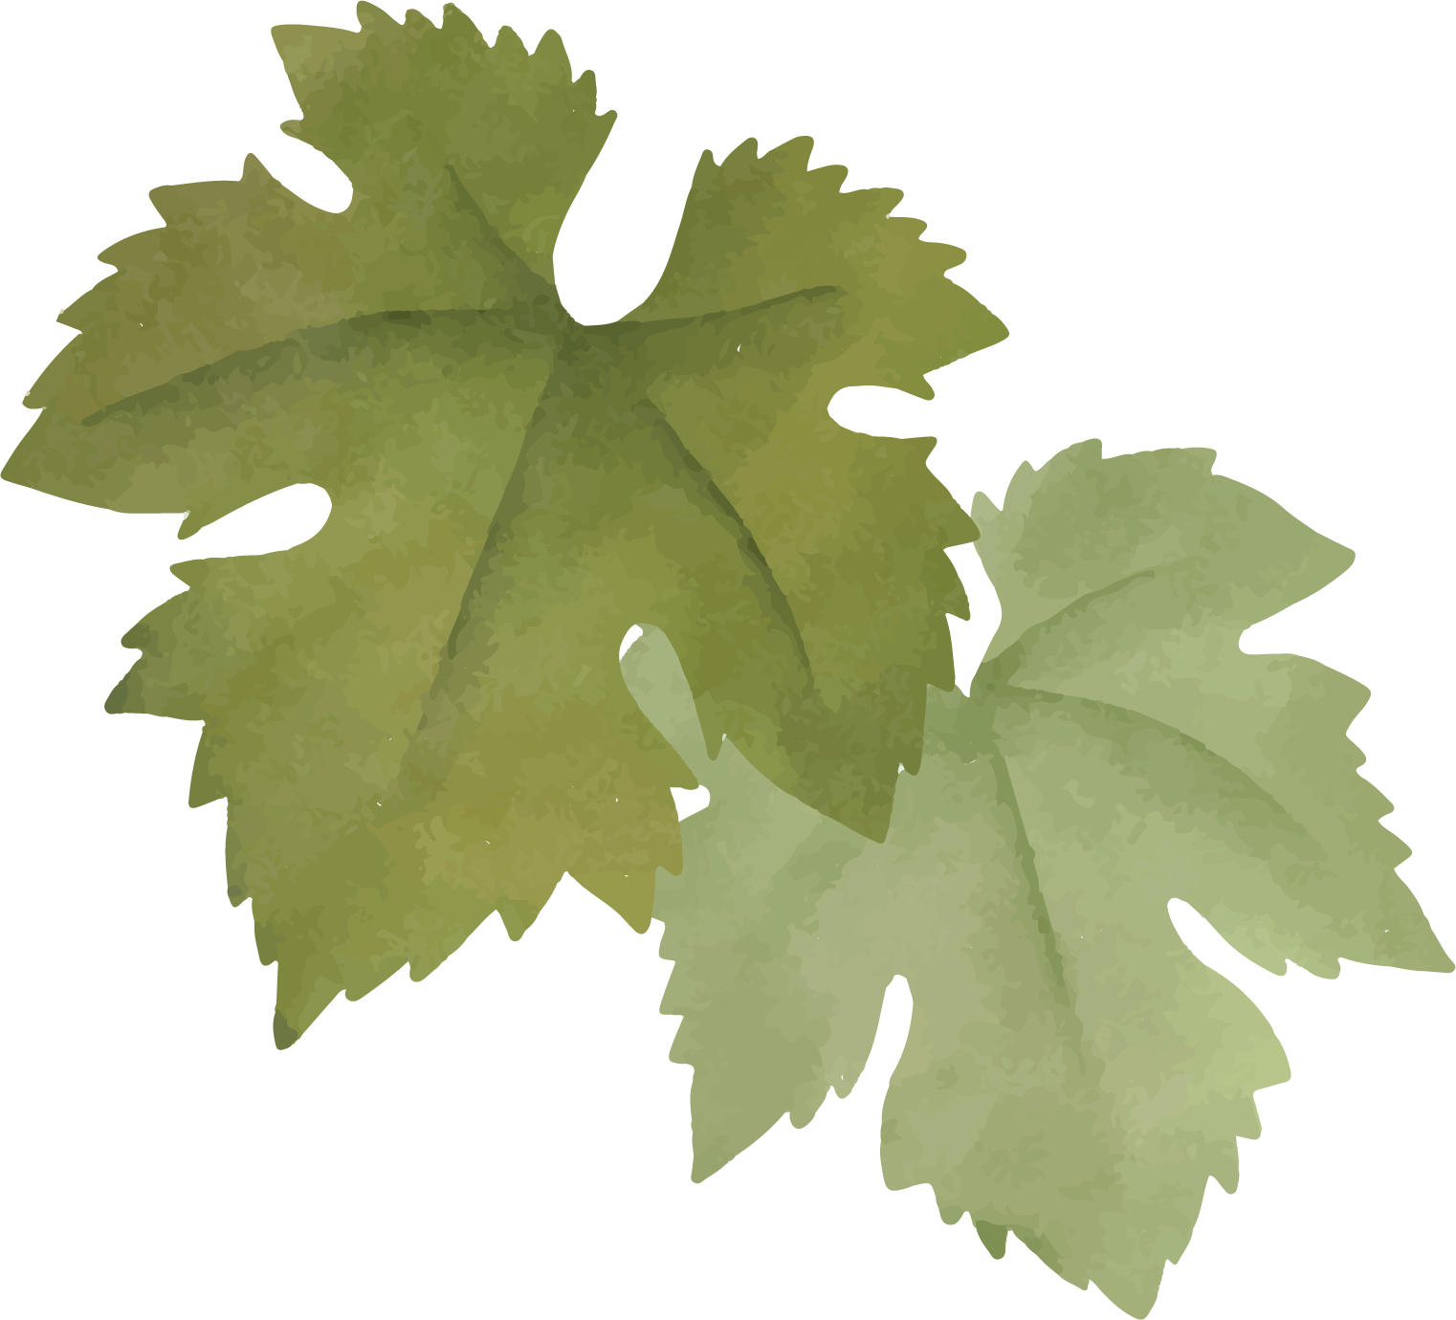
Links :
Deployed Link
Repository Link
https://glistening-hamster-0fe3d4.netlify.app/
https://github.com/boxitooo6629/Wine-Food-Pairing-App
Notes:
Blago:
Gellert:
Bronwen:

Slide 19
Thanks!
Please feel free to ask any questions you may have regarding this project.
Please keep this slide for attribution
Notes:
Blago:
Gellert:
Bronwen:

